Slide 1
Identifying Truck Bias In LBS Data
Texas A&M Transportation Institute
Byron Chigoy, TTI
Gargi Singh, TTI
17th TRB National Transportation Planning Applications Conference
Portland, Oregon
Monday June 3, 2019
Notes:
Introduce your self, live in North Carolina, small farming and foraging in the black mountains, philosophy
Tell about planning background – Major Corridor Investments, Tolling, Statewide Planning and Programming, Sub-area studies (Fort Hood, Sam Houston).
Tell about my team – privilege of being technical lead of Survey and Big Data analytics team.

Slide 2
Origin-Destination Platforms
Technology Comparison | BT/Wi-Fi Retired to ITS | GPS Venerable War Horse | Cellular Temporarily Gone but Not Forgotten | LBS Oracle of Delphi | Cellular Signal What will They Think of Next?
Type of Travel Collected | Trips between device readers | Estimated trips traces | Estimated device movements | Device locations | Device Location on Roadbed
Detection Platforms | Roadside Equipment, Built Environment (lighting, signals etc) | Logging devices for Fleet Tracking, Navigation systems, Travel Surveys | Cell Phones, Tablets, Cell Towers | Generally Application Software Development Kits (SDKs) | Any device that interacts with the Cell Network
What’s Detected | MAC Address of Cell or Devices actively using BT, in vehicle BT such as Tire Pressure Monitoring Systems (TPMS) Wifi signals | Device and Provider ID GPS Transmissions and Logs | Device ID of Call Detection Records (CDR), device network pings, device events (text, internet browse), Cellular GPS | Device ID and Ad ID linked to GPS, Wi-Fi interactions, ISP location, assumed location based on app personal info entry | Number of Devices Unique Cell signal patterns on corridors

Slide 3
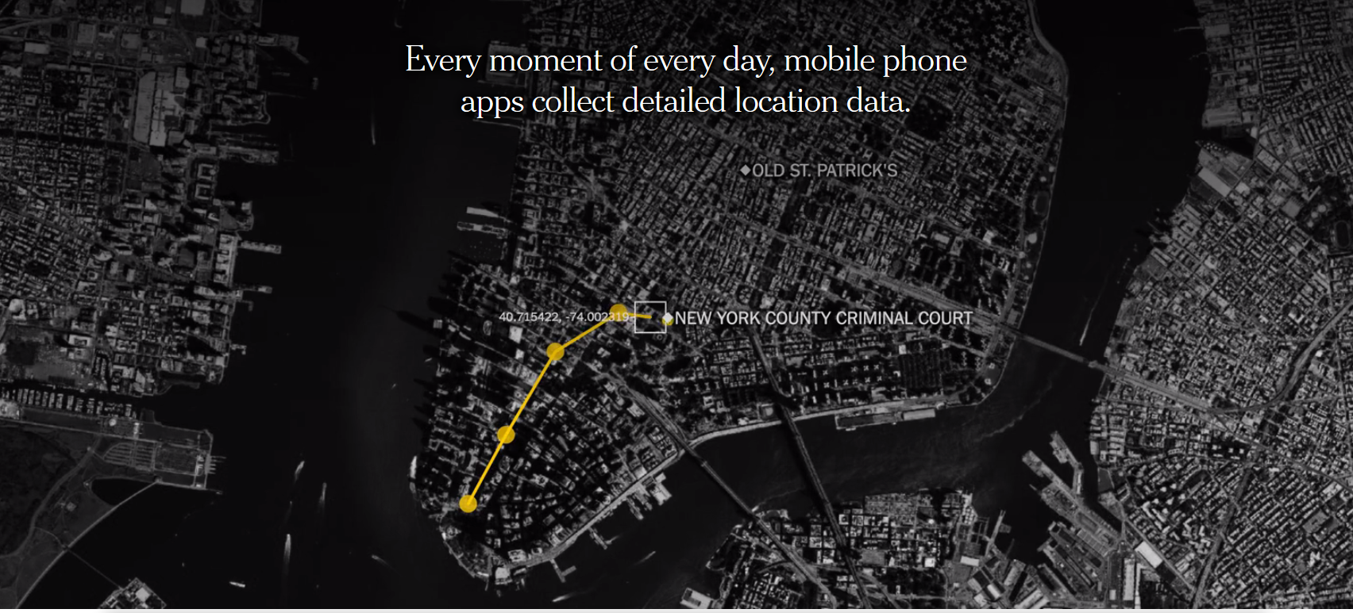
LBS: Eye in the Sky (and in your pocket)¹
https://www.nytimes.com/interactive/2018/12/10/business/location-data-privacy-apps.html
¹Alan Parsons Project

Slide 4
LBS Data; Do We Have the Same Terms?
I’m confused and why you should be too.
Which apps are included in the panel?
How does it work? – exactly!
GPS?
Global System for Mobile Communications (GSM) – e.g Cellular?
User input/assumed?
Proxy location/beacon (e.g. Wi-Fi interaction)?
How frequent are locations? Temporal distribution of use? Is it really as big as the claims?
How do you obtain it?
And - How do we the buyers define quality – rather than the providers?
Notes:
Hold this slide for a moment -

Slide 5
Do We Know the Bias in LBS? It’s a secret
Potential Biases
The ones you know
Age
Income
Mode
Gender
Geographic Distribution
Types of Trips
Less Obvious – But Critical
How trips are determined/broken
Type of LBS position used
App use frequency
Temporal use of App
Geographic Distribution
Big Data/ “The Algorithm”
Classifications – how done
Expansion methods
Notes:
In the future driverless cars
Location is place of detection by device or observation
Place is where they are really going and where they are coming from
AND Place may be Different depending on What You are interested in – Long distance, maybe not the gas station

Slide 6
Truck Bias You Say?
Yes (But Why Propose That?)
Truck and Commercial Vehicle Drivers Use Apps and Cell Phones too
So we should see some evidence of this in LBS data sources – both aggregate and disaggregate?

Slide 7
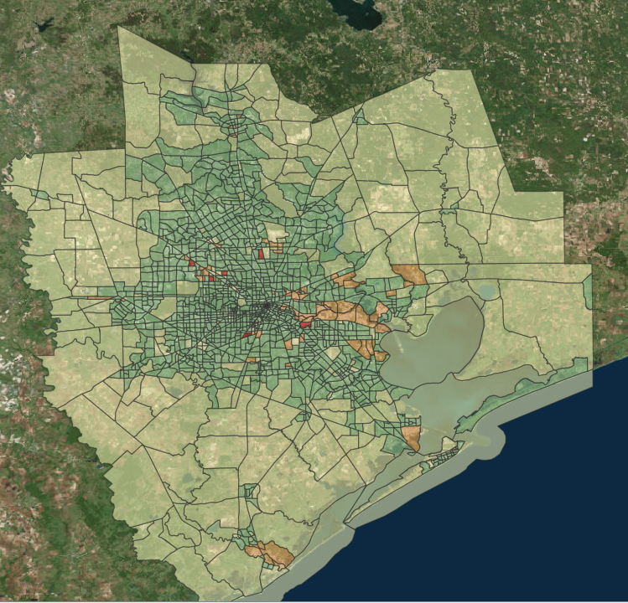
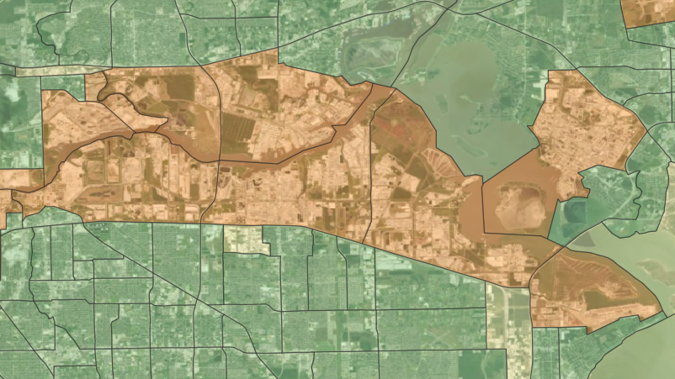
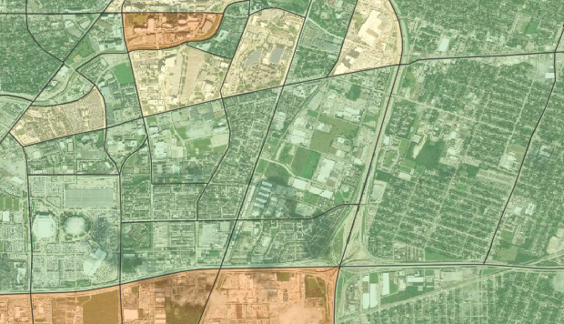
Where We Looked, and What We Used?
Houston-Galveston
Industrial Zone
Data Sources
AirSage 2017
LANDSAT
H-GAC TAZs and Employment
Residential/Mixed Use

Slide 8
What We Found
Percent of Trips by Land Use
 | HBW | HBO | NHB
Residential/Mixed Use | 14% | 48% | 38%
Industrial | 14% | 46% | 40%
Other | 14% | 46% | 40%

Slide 9
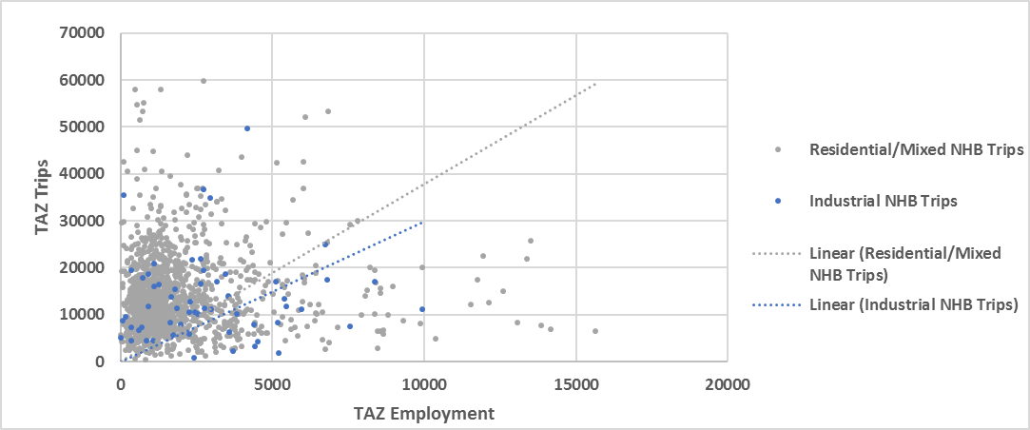
What We Found
Percent of Trips by Land Use

Slide 10
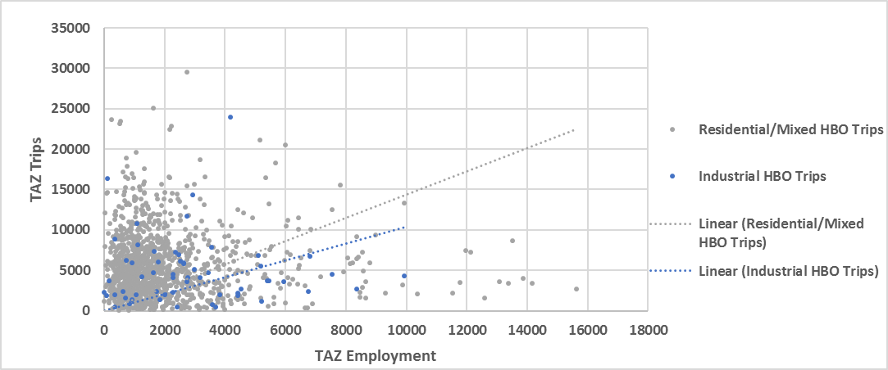
What We Found
Percent of Trips by Land Use

Slide 11
And Why We Did Not Find Anything
Aggregate LBS data is insufficient for the task
Not enough land use categories
Truck and commercial vehicle drivers are not using the same apps as general population
Need more robust methodology
Not asking the right question

Slide 12
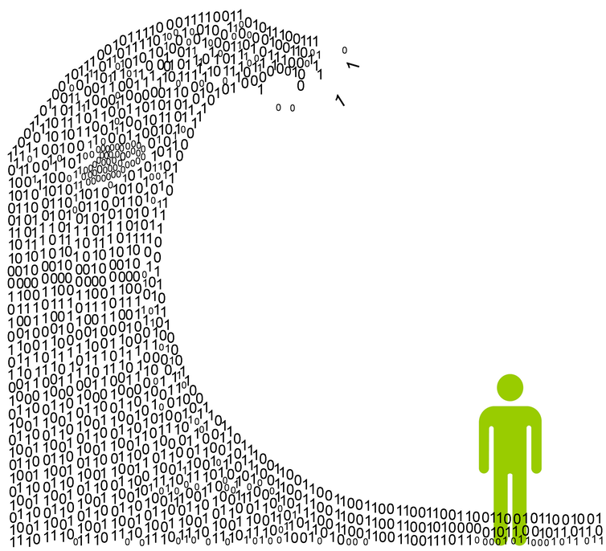
Just a Few Things to Think About (but there are more)
Agencies need to invest in technical resources and professionals to analyze passive OD data/Big Data
In-house, in-depth understanding of data critical
With LBS and Cellular data - we still really do not know a lot about the data processing methodologies
Need for critical thought and analysis of Big Data Sources

Slide 13
Special Thanks and Acknowledgments
Bill Knowles
Janie Temple
Christeen Pusch
Ed Hard
Michael Martin
LD White
Mark Ojah
Stella Nepal
Lisa Greene

